Slide 1
Cryptography and Network Security
Dr. Preeti Chandrakar
Assistant Professor
Computer Science & Engineering, NIT, Raipur
Dr. Preeti Chandrakar
1
Notes:
1

Slide 2
OBJECTIVES:
To introduce security goals and to discuss the types of attacks that threaten these goals.
To introduce traditional ciphers as symmetric-key ciphers to create the background for understanding modern symmetric-key ciphers.
To discuss the general idea behind asymmetric-key ciphers and introduce common cipher in this category.
To discuss message integrity and show how to use a cryptographic hash function and digital signatures to create a message digest.
To apply cryptography as a tool to provide security along with Kerberos, X.509, authentication services, E-mail security, PGP, S/MIME.
Dr. Preeti Chandrakar
2
Notes:
2

Slide 3
Books:
Forouzan, Behrouz A., and Debdeep Mukhopadhyay. Cryptography and Network security (Sie). McGraw-Hill Education, 2011.
W. Stallings,”Cryptography and Network Security Principles and practice”, 5/e, Pearson Education Asia, 2013.
Kahate, Atul. Cryptography and network security. Tata McGraw-Hill Education, 2013.
Links:
https://lecturenotes.in/subject/112/cryptography-and-network-security-cns.
http://studentsfocus.com/cs6701-cns-notes-cryptography-network-security-lecture-handwritten-notes-cse-7th-sem-anna-university/
http://williamstallings.com/Extras/Security-Notes/
Dr. Preeti Chandrakar
3

Slide 4
Computer Security: Why
Information is a strategic resource
In this digital world, information is very important for survival
Preventing illegal access to your personal financial information begins with you protecting your information
A significant portion of organizational budget is spent on managing information
Dr. Preeti Chandrakar
4
Notes:
4

Slide 5
Information Security
Information security refers to the processes and methodologies which are designed and implemented to protect print, electronic, or any other form of confidential, private and sensitive information or data from unauthorized access, use, misuse, disclosure, destruction, modification, or disruption.

Slide 6
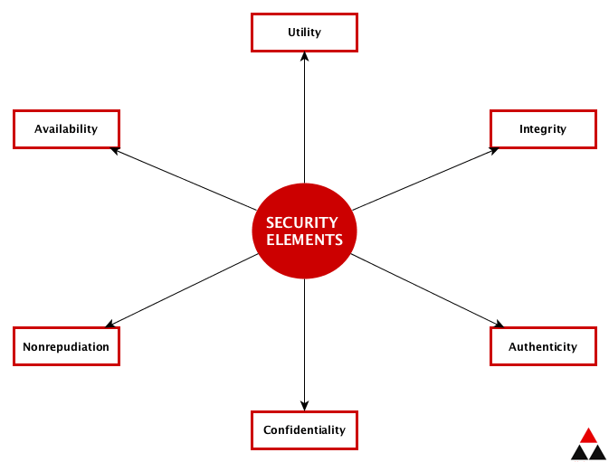
Security Services
Dr. Preeti Chandrakar
6

Slide 7
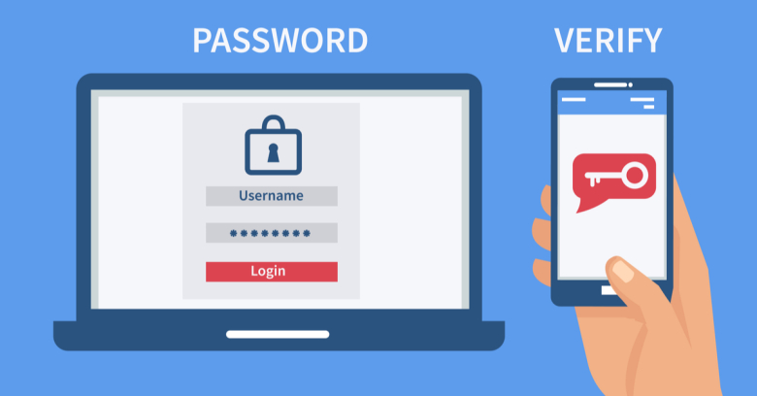
Authentication
Authentication is the process of recognizing a user’s identity
Authentication is an important security mechanism through which two or
more communicating parties could authenticate each other

Slide 8
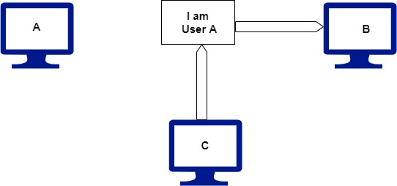
Security Goals
Authentication
Establish proof of identities
It ensures that the origin of a message or document is correctly identified
User C posing as user A and send a fund transfer request to bank B. The bank transfer the funds from A’s account to C’s account, it think that user A has requested for the funds transfer. This type of attack is called as fabrication

Slide 9
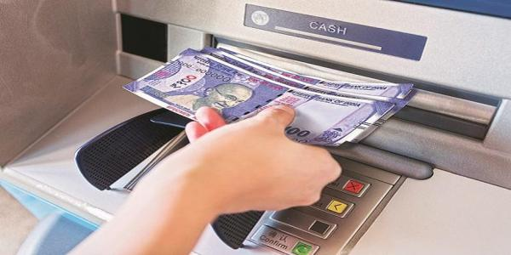
Integrity
Integrity means that the changes need to be done only by authorized entities and through authorized mechanism
Data integrity is designed to protect data from modification, insertion, deletion, and replying by an attacker
Dr. Preeti Chandrakar
9

Slide 10
Confidentiality
Confidentiality is used to prevent sensitive information from reaching the wrong people, while making sure that the right people can in fact get it
Confidentiality assures that data can not be viewed by an unauthorized user
It sometimes referred to as secrecy
Data confidentiality is designed to protect data from disclosure attack
It is designed to prevent snooping and traffic analysis attack

Slide 11
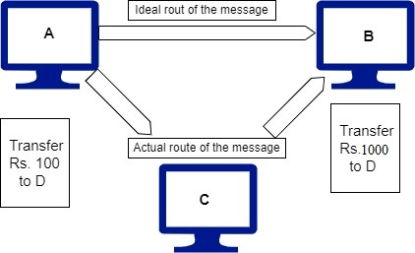
Security Goals
Integrity
Contents of a message are changed after the sender sends it, but before it reaches the intended recipient
User C change the contents and send changed message to user B. User A and B does not know about this change. This type of attack is called as modification

Slide 12
Nonrepudiation
Nonrepudiation service protects against repudiation by either the sender or the receiver of the data
It ensures that en entity cannot deny a previous commitment or action
In nonrepudiation with proof of the origin, the receiver of the data can later prove the identity of the sender if denied
In nonrepudiation with proof of delivery, the sender of data can later prove the data were delivered to the intended recipient.
Dr. Preeti Chandrakar
12

Slide 13
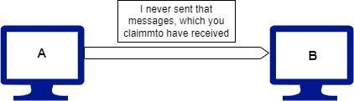
Security Goals
Non-repudiation
It does not allow the sender of a message to refute the claim of not sending that message

Slide 14
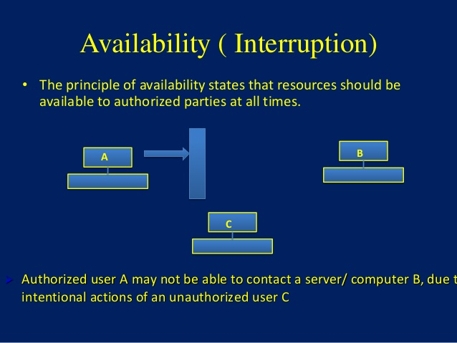
Availability of information refers to ensuring that authorized parties are able to access the information when needed
Information only has value if the right people can access it at the right times
Dr. Preeti Chandrakar
14

Slide 15
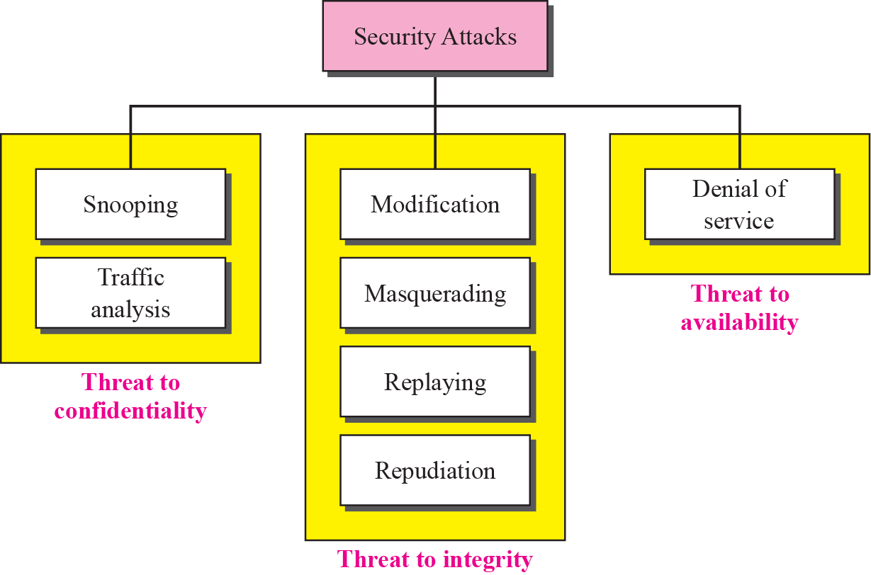
Security Attacks:
Passive Attack
Dr. Preeti Chandrakar
15
Active Attack

Slide 16
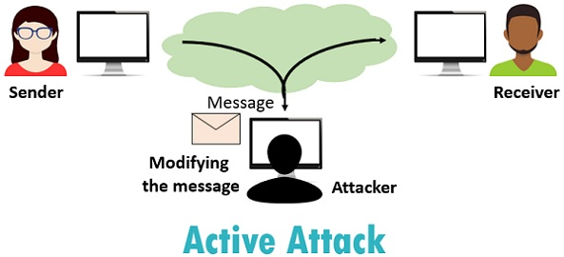
Active Attack
An active attack may change the data or harm the system
Active attacks threaten the integrity and availability
Active attacks are normally easier to detect than to prevent
Modification, Masquerading, Replaying and Repudiation are active attacks
Dr. Preeti Chandrakar
16

Slide 17
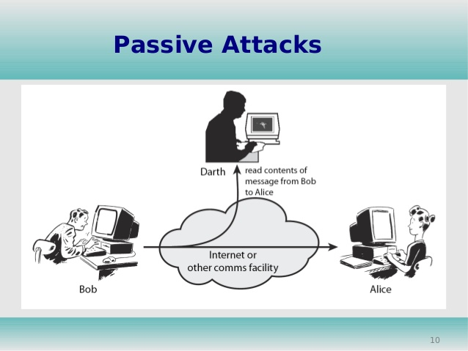
Passive Attack
The attacker goal is just to obtain the information
Attack does not modify data or harm the system
Active attacks threaten the Confidentiality
Snooping and Traffic analysis are passive attacks
Dr. Preeti Chandrakar
17

Slide 18
Snooping
It refers to unauthorized access to o r interception of data.
The confidentiality of data threatened by snooping.
It is type of passive attack.
Example
A file transferred through the internet may contain confidential information. An unauthorized entity may intercept the transmission and use the contents for her own benefits.
Dr. Preeti Chandrakar
18

Slide 19
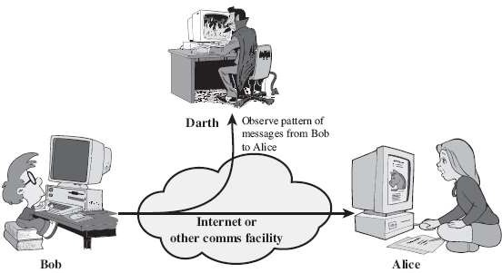
Traffic Analysis
Attacker can obtain some other type information by monitoring online traffic
Example
She can find the electronic address of the sender or the receiver. She can collect pairs of request and responses to help her guess the nature of transaction
Dr. Preeti Chandrakar
19

Slide 20
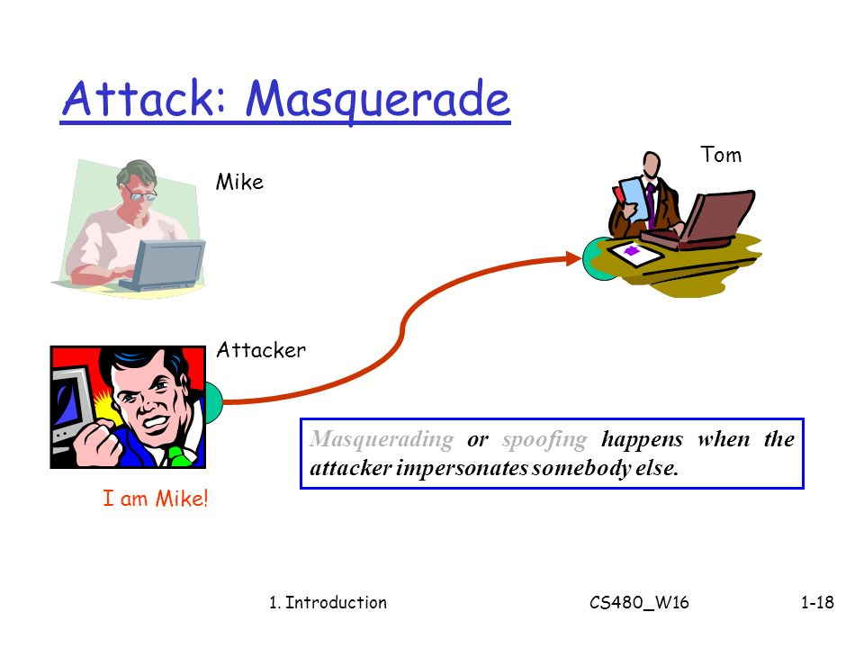
Example:
An attacker might steal the bank card and PIN of a bank customer and pretend that she is that customer.
A user tries to contact a bank, but another site pretends that it is the bank and obtains some information from the user.
Dr. Preeti Chandrakar
20

Slide 21
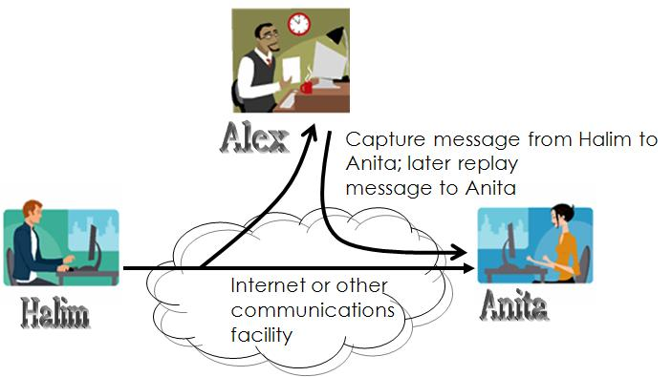
Replay Attack
Example
A person sends a request to her bank to ask for payments. Attacker intercepts the message and sends it again to receive another payments from the bank.
Dr. Preeti Chandrakar
21

Slide 22
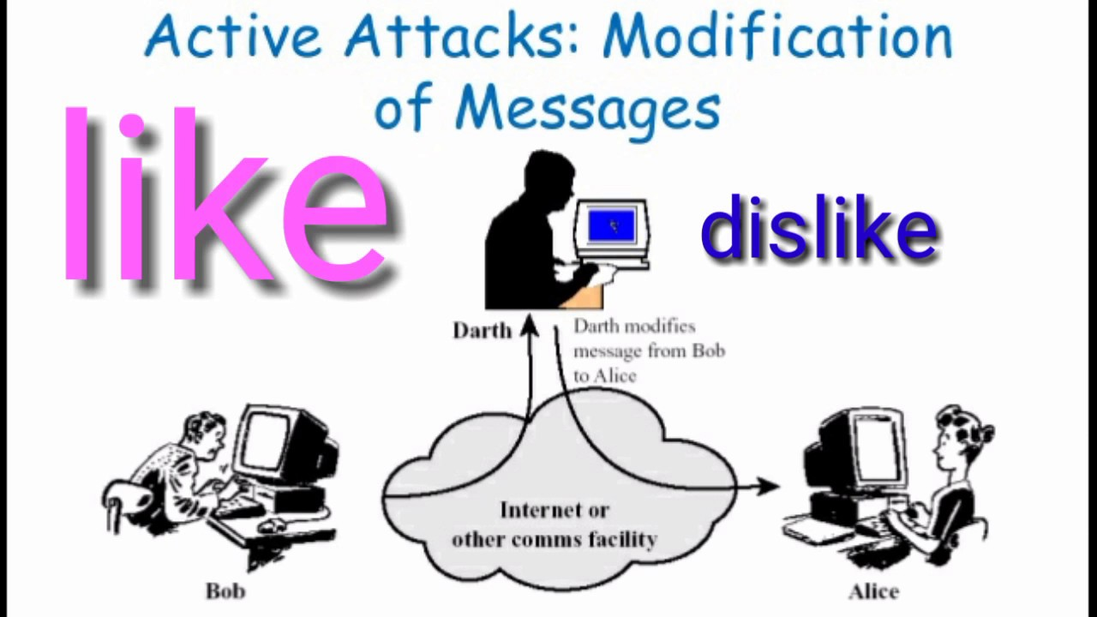
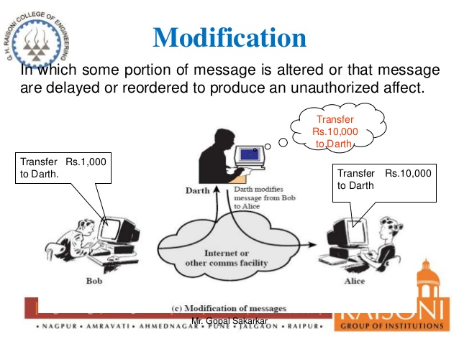
Modification Attack
Example
Dr. Preeti Chandrakar
22

Slide 23
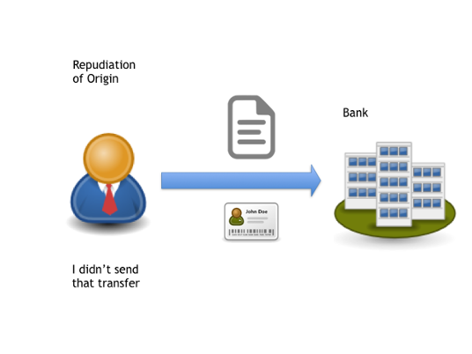
Repudiation
The sender of the message might later deny that she has sent the message ; the receiver of the message might later deny that he has received the message
Dr. Preeti Chandrakar
23

Slide 24
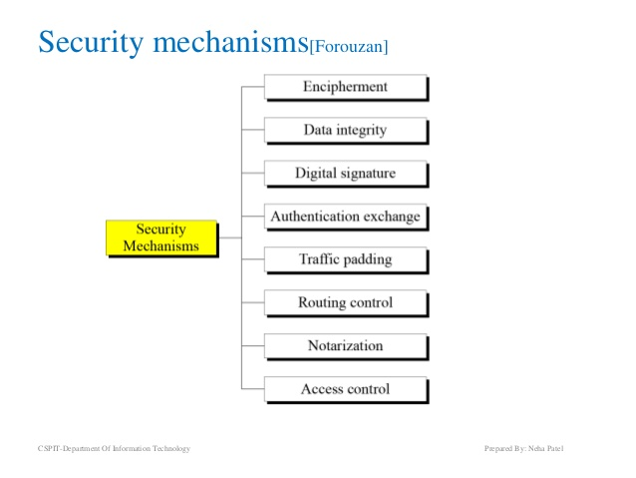
Dr. Preeti Chandrakar
24

Slide 25
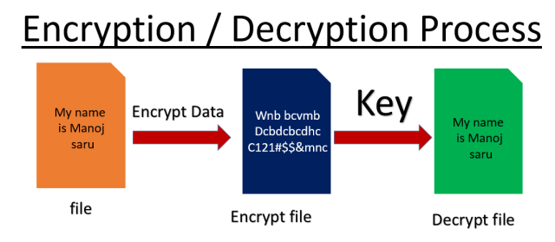
Encipherment- This is hiding or covering data, which provides confidentiality. The use of mathematical algorithms to transform data into a form that is not readily intelligible
Dr. Preeti Chandrakar
25

Slide 26
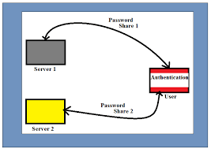
Authentication Exchange- In authentication exchange, two entities exchange some messages to prove their identity to each other.

Slide 27
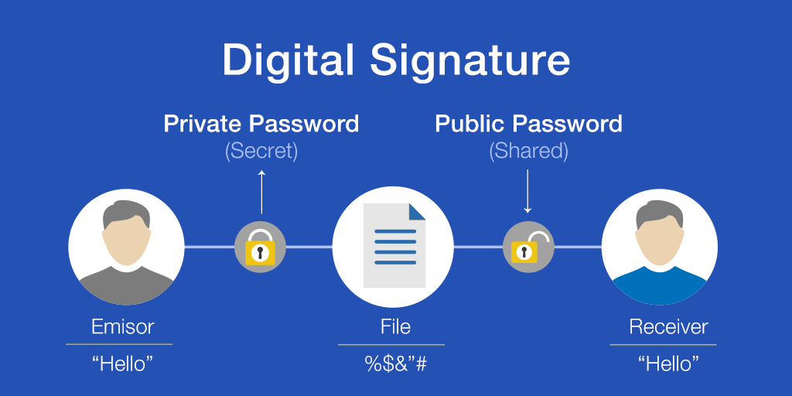
Digital Signature- The sender can electronically sign the data and the receiver can electronically verify the signature

Slide 28
Access Control- Access control uses methods to prove that a user has access right to the data or resource owned by a system Routing Control- Routing control means selecting and continuously changing different available routes between sender and receiver to prevent the opponent from eavesdropping on a particular route. Traffic padding may be used to hide the traffic pattern, which means to insert dummy traffic into the network and present to the intruder a different traffic pattern. Data Integrity- The data integrity mechanism appends to the data a short check value that has been created by a specific process from the data itself. Data Integrity is preserved by comparing checked value received to check value generated.
Dr. Preeti Chandrakar
28

Slide 29


Cryptography is the science and art of transforming messages across insecure channel so that it can not be read by anyone except the intended recipient

Slide 30
Cryptography is the study of secure communications techniques that allow only the sender and intended recipient of a message to view its contents.
The term is derived from the Greek word kryptos, which means hidden.
It is closely associated to encryption, which is the act of scrambling ordinary text into what's known as ciphertext and then back again upon arrival.

Slide 31
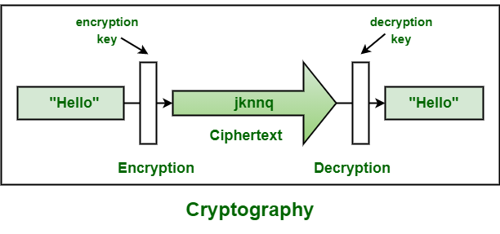

Slide 32
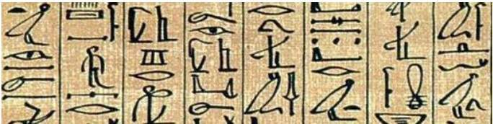
Hieroglyph − The Oldest Cryptographic Technique
The first known evidence of cryptography can be traced to the use of ‘hieroglyph’. Some 4000 years ago
The Egyptians used to communicate by messages written in Hieroglyph.
This code was the secret known only to the scribes who used to transmit messages on behalf of the kings
One such hieroglyph is shown below.

Slide 33









Slide 34




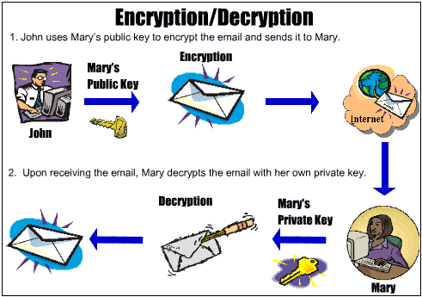

Slide 35












SYMMETRIC KEY CRYPTOGRAPHY
ASYMMETRIC KEY CRYPTOGRAPHY

Slide 36










SENDER
RECEIVER
SECRET KEY
ENCRYPTION
DECRYPTION
CIPHERTEXT

Slide 37
Symmetric Key Cryptography-
Symmetric Key Cryptography also known as Symmetric Encryption is when a secret key is used for both encryption and decryption functions.
Both sender and receiver uses a common key to encrypt and decrypt the message.
This secret key is known only to the sender and to the receiver.
It is also called as secret key cryptography.

Slide 38
Working-
Before starting the communication, sender and receiver shares the secret key.
This secret key is shared through some external means.
At sender side, sender encrypts the message using his copy of the key.
The cipher text is then sent to the receiver over the communication channel.
At receiver side, receiver decrypts the cipher text using his copy of the key.
After decryption, the message converts back into readable format.

Slide 39
Symmetric Encryption Algorithms-
Some of the encryption algorithms that use symmetric key are
Advanced Encryption Standard (AES)
Data Encryption Standard (DES)

Slide 40
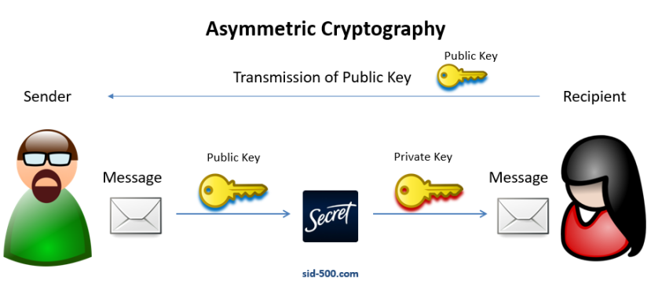

Slide 41
Asymmetric Key Cryptography-
Sender and receiver use different keys to encrypt and decrypt the message.
It is called so because sender and receiver use different keys.
It is also called as public key cryptography.

Slide 42
Working-
The message exchange using public key cryptography involves the following steps-
Step-01:
At sender side,
Sender encrypts the message using receiver’s public key.
The public key of receiver is publicly available and known to everyone.
Encryption converts the message into a cipher text.
This cipher text can be decrypted only using the receiver’s private key.
Step-02:
The cipher text is sent to the receiver over the communication channel.
Step-03:
At receiver side,
Receiver decrypts the cipher text using his private key.
The private key of the receiver is known only to the receiver.
Using the public key, it is not possible for anyone to determine the receiver’s private key.
After decryption, cipher text converts back into a readable format.

Slide 43
Asymmetric Encryption Algorithms
The famous asymmetric encryption algorithms are-
RSA Algorithm
Diffie-Hellman Key Exchange

Slide 44
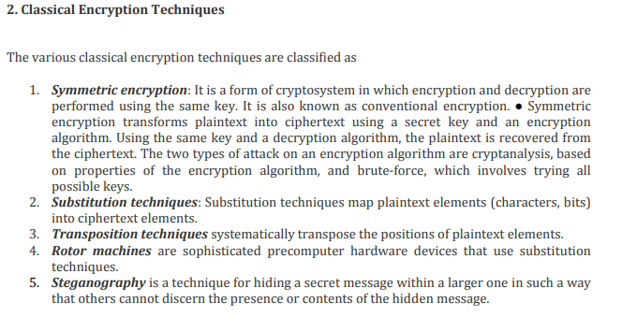
Dr. Preeti Chandrakar
44

Slide 45
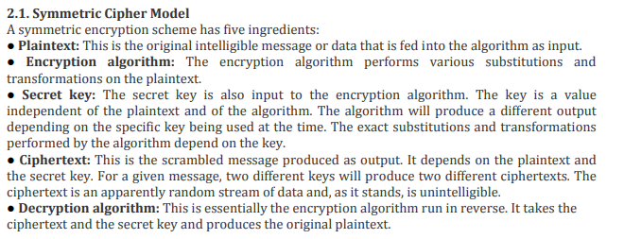
Dr. Preeti Chandrakar
45

